Slide 1

Parent Training: Related Services for Students
Receiving Special Education Services
Wednesday, March 20, 2024

Slide 2





1. Mute your microphone | 2. Be respectful
3. Background | 4. Appropriate comments
Virtual Meeting Norms

Slide 3
Related Services

Slide 4
Related services are a wide array of supportive services provided to children with disabilities to assist them in benefiting from special education
IDEA defines related services as transportation and such developmental, corrective, and other supportive services necessary for a child with a disability to benefit from special education
Individuals with Disabilities Education Act (IDEA)

Slide 5
The need for related services is considered during the student’s ARD meeting based on the evaluation and assessment data
  An evaluation for the related service must be completed to determine the student’s need for the related service
An ARD committee is responsible for determining appropriate educational services, including related services, based on the individual educational needs of a student.
  Related services are NOT determined based on a particular disability category
Need for Related Services

Slide 6
Direct Services:
  Usually refer to hands-on, face-to-face interactions between the related services professional and the student
  Takes place in a variety of settings (classroom, gym, health office, resource room, counseling office, or playground)
Indirect Services:
  May involve teaching, consulting with, and/or directly supervising other personnel so that they can carry out therapeutically appropriate activities
Direct and Indirect Services

Slide 7
Types of
Related Services

Slide 8
Audiology
School Health
Counseling
Transportation
Physical Therapy
Vision
Occupational Therapy
In-Home/Parent Training
Adapted Physical Education
Orientation and Mobility

Slide 9
School-Based Occupational Therapy
School-based Occupational Therapists provide interventions and support in order to help students access and participate in their educational environment.
Occupational Therapy with students in the school setting must be educationally relevant.
Therapists work with students and teachers to help develop functional strategies that a student may need for them to access their educational materials, educational environment, or participate in school-based self-help tasks.
Interventions may occur in the classroom, playground, lunchroom, or restroom.

Slide 10
Occupational Therapy
Direct Services
Direct services are provided directly to the student by the occupational therapist or teacher.
Indirect Services
Indirect services are not provided directly to the student but are provided to the teacher or other staff members who work with the student by the OT.

Slide 11
Occupational Therapy:
Resources for Handwriting
Starfall Parent-Teacher Center
https://teach.starfall.com/worksheets?worksheetType=customizable&gradesChosen=all&subjectsChosen=ELA&searchTerm=&page=1&perPage=20&sortBy=title&sortDirection=asc&selectSort=title_asc
CreatePrintables
https://www.createprintables.com/name-tracing-worksheet-practice/

Slide 12

Counseling
What We Look For:
- Comprehensive assessment of emotional, social, and behavioral functioning
- Identification of strengths, challenges, and areas for growth
- Exploration of coping skills, self-regulation, and interpersonal relationships
- Collaboration with students, parents, and educators to gather diverse perspectives
- Development of tailored intervention plans to support emotional well-being and academic success
Types of Evaluations:
Part of a Full and Individual Evaluation
- Comprehensive assessment of emotional, social, and behavioral functioning
- Integration of counseling evaluations with other assessments (e.g., academic, behavioral)
- Development of comprehensive intervention plans aligned with individualized education goals
Stand-Alone Evaluation
- Focused assessment of specific emotional or behavioral concerns
- Targeted exploration of coping strategies and social-emotional development
- Designed to address specific areas of concern and provide targeted intervention recommendations
This Photo by Unknown author is licensed under CC BY-SA.

Slide 13

Counseling
Direct Related Services Counseling:
- Individual Counseling Sessions: Providing one-on-one counseling to address specific emotional, social, or behavioral concerns, such as anxiety, self-regulation, or social skills development.
- Social Skills Groups: Facilitating group sessions to teach and practice social interaction, communication, and relationship-building skills among peers.
Indirect Related Services Counseling:
- Consultation with Teachers and Staff: Collaborating with educators to develop strategies for supporting students' social-emotional needs within the classroom environment.
-Model skill or strategy for teacher, have teacher model back to ensure the teacher understands what and how to provide the support in the natural classroom setting.
- Parent Education and Support: Providing resources, guidance, and support to parents to address their child's emotional and behavioral challenges at home.
This Photo by Unknown author is licensed under CC BY-SA.

Slide 14

Counseling
Resources
FBISD link to affordable counseling services:
https://www.fortbendisd.com/cms/lib/TX01917858/Centricity/Domain/2358/Affordable%20Counseling%20Resources%20for%20Students.pdf
Katy Psychological Services:
https://www.katypsychservices.com/
West Houston Psychology:
https://www.westhoustonpsychology.com/
Missouri City Family Counseling:
https://missouricityfamilies.com/
This Photo by Unknown author is licensed under CC BY-SA.

Slide 15
Physical Therapy
What is school based physical therapy?
A related service, that is not instructional and provides additional support to a student that is currently receiving special education.
The goal is to help students with significant physical challenges to access and participate to their fullest ability in their individualized educational program
Identify any barriers that may exist limiting the child's current functional participation at school
Who is eligible for PT services
Students that are eligible for special education can be referred for a screen and then an evaluation if needed
SPED student that has difficulty with positioning and access which limits their individualized educational program
SPED student that has barriers to access or participation in the school setting
How are services determined?
An educational physical therapy evaluation is performed to determine an educational need.
Referred by an ARD/IEP committee not by a physician

Slide 16
Physical Therapy
Ide
Direct and indirect Services
Services are integrated into the classroom to support the student, teacher and staff to address barriers limiting the student's participation in their special education program
Direct- services are face to face with the student
  Working with the student directly related to their IEP goals
  Training the staff with the student present on transfers, mobility, positioning and any adaptive equipment
Consult- teaching and/or consulting to provide expertise to solve problems related to a student's ability to access and participate in their special education program
  Consulting and collaboration with teachers to address needs
  Adaptive equipment modifications
  Identifying and problem solving any adaptive equipment needs

Slide 17
Physical Therapy
Resources for parents:
https://www.hcde-texas.org/txspot/resources/PT
https://www.hcde-texas.org/txspot/practice-faqs
https://www.hcde-texas.org/txspot/faqs-service-delivery
https://www.hcde-texas.org/txspot/resources/PT
https://www.region10.org/programs/occupational-and-physical-therapy-services/school-based-vs-clinical-based-therapy/

Slide 18
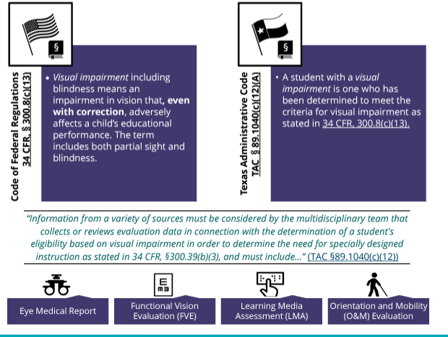
Vision
***Orientation and Mobility is a related-service that is only available to students who qualify as VI and requires its own evaluation. For an initial FVE, O&M will always be included. Not all students who are VI require O&M services.

Slide 19
Vision
DIRECT
INDIRECT
ECC
Assistive Technology (screen readers, refreshable braille systems)
Braille
Access to curriculum for coursework
Working with teachers on access/creating adapted materials
Collaborating with staff at TSBVI
Services provided by a CTVI (Certified Teacher for the Visually Impaired)
NOT VISION THERAPY
VI
Navigate the home/daycare safely- familiarity
How to navigate the school- find the restroom, cafeteria
How to detect and/or cross a street safely
O&M specialist will work with parents and staff members to support correct use of the cane
O&M will work with parents and staff to foster independence
Services provided by a COMS (Certified Orientation and Mobility Specialist)
O&M

Slide 20

The Expanded Core Curriculum (ECC) refers to nine categories of experiences and concepts casually and incidentally learned by sighted students that need to be systematically and sequentially taught to learners who are visually impaired, through their educational teams. It is addressed as part of the FVE (Full Vision Evaluation) and is part of every annual ARD.
Communication Modes
Orientation and Mobility
Social Interaction Skills
Independent Living Skills
Recreation and Leisure Skills
Career Education
Assistive Technology
Sensory Efficiency Skills
Self-Determination
Vision
This Photo by Unknown author is licensed under CC BY-SA-NC.

Slide 21
Vision: Parent Resources
https://spedsupport.tea.texas.gov/resource-library/students-visual-impairments-eligibility-special-education
Texas School for the Blind and Visually Impaired: https://www.tsbvi.edu/
American Publishing House: https://www.aph.org/kids-with-vision-loss/
Perkins School for the Blind: https://www.perkins.org/
Paths to Literacy: https://www.pathstoliteracy.org/resource-type/resource/
TSBVI Parent Letter: https://www.yumpu.com/en/document/view/35200658/parent-flyer-texas-school-for-the-blind-and-visually-impaired#google_vignette

Slide 22
Adapted Physical Education
IDEA
General IDEA Requirements includes instruction in physical education within the definition of special education
“Special education means specially designed instruction, at no cost to the parents, to meet the unique needs of a child with a disability, including— …instruction in physical education.”
“Physical education means the development of:
• Physical and motor fitness;
• Fundamental motor skills and patterns; and
• Skills in aquatics, dance, and individual and group games and sports (iincluding intramural and lifetime sports); and
• Includes special physical education, adapted physical education, movement education, and motor development.”
“Specially designed instruction means adapting, as appropriate to the needs of an eligible child under this part, the content, methodology, or delivery of instruction—
• To address the unique needs of the child that result from the child's disability; and
• To ensure access of the child to the general curriculum, so that the child can meet the educational standards within the jurisdiction of the public agency that apply to all children.

Slide 23
Adapted Physical Education
Physical Education: The State must ensure that public agencies comply with the following:
(b) Regular physical education. Each child with a disability must be afforded the opportunity to participate in the regular physical education program available to nondisabled children unless:
(1) The child is enrolled full time in a separate facility; or
(2) The child needs specially designed physical education, as prescribed in the child's IEP.
(a) General. Physical education services, specially designed if necessary, must be made available to every child with a disability receiving FAPE, unless the public agency enrolls children without disabilities and does not provide physical education to children without disabilities in the same grades.

Slide 24
Adapted Physical Education
Purpose of Adapted Physical Education (AdPE) Services Adapted PE is an individualized service comprised of developmental activities, games, sports, and rhythmical movements suited to the interests, capacities and limitations of students with disabilities who may or may not safely or successfully engage in the activities of a general physical education program due to physical gross motor concerns Instructional and consultative, services are provided to students in the least restrictive environment.
Adapted physical education instruction is specified in an individualized education program (IEP) and shall meet the standards of the TEKS. Its purpose is to provide a physical education program in which the activities and teaching procedures are adapted to the specific strengths and limitations of students with disabilities who cannot participate in the general physical education program or who need adaptations for safe and successful participation.

Slide 25
Adapted Physical Education
REFERRAL PROCESS
If a student is not making progress in physical education, the student’s case manager should be contacted to review the current IEP and ensure appropriate accommodations and other services are implemented as necessary (AT, BIP, etc.), If the student requires additional support, the CCC/ARD Facilitator should be contacted. Screening may be warranted to gain additional information prior to the evaluation. If so, the campus CCC/ARD Facilitator obtains consent for screening. If no screening is warranted, consent for the Evaluation will be obtained.
Based on the results of the evaluation, the service provider will make recommendations about the need for service and make recommendations for service delivery time, and frequency and duration of services.

Slide 26
Adapted Physical Education
SERVICE MODELS
Direct: This model has the Adapted Physical Education teacher working directly with the student either in the general education setting or as a pull-out service.
Consultation or Indirect: This model is the least restrictive and allows for the Adapted Physical Education teacher to consult with the coach and/or classroom staff providing strategies and equipment if needed to facilitate success in PE.
Service time will be based on the needs of the student as determined in the evaluation.
Dismissal: Dismissal from Adapted Physical Education will be based on student mastery of IEP goals over time or once the student has earned the Physical Education requirement for graduation.

Slide 27
Adapted Physical Education
SPECIAL OLYMPICS
The Adapted Physical Education staff works closely with the Fort Bend Falcons Special Olympics team.
COMPONENTS
vMultiple sports throughout school year
vSports training and competition
vOlympic-type sports
vIndividual with intellectual disability
OUTCOMES
vPhysical fitness
vCourage and joy
vSharing of gifts and skills
vFriendship: Families, Athletes, Community
To join Special Olympics, download the SportsYou app on your device
Team Code: YWYA-XF8U
EMAIL:
Laura Rivers (Head of Delegation) Robert McGuire (Head of Delegation)
Laura.rivers@fortbendisd.com Robert.mcguire@fortbendisd.com

Slide 28
In-Home/Community Based & Parent Training
After all Viable Options are exhausted and there is a possible need for In-Home / Community Based and/or Parent Training (IH/CB/PT):
01
Parents sign the Notice and Consent for IHT evaluation and is obtained by the campus Licensed Specialist in School Psychology (LSSP)
02
Once consent is obtained the campus LSSP will complete the evaluation components which include a gathering of student historical information, a parent interview, teacher interview, school observation, in-home observation and an evaluation summary report
03
After the evaluation is completed, the LSSP will input PROPOSED IEP goals/objectives, into the draft ARD documents. A recommended number and duration of sessions will be added to the draft schedule of service page. The LSSP will document areas of need/service time on the draft Autism Supplement within the ARD document. This information is shared with the parent to review prior to the ARD meeting.
04

Slide 29
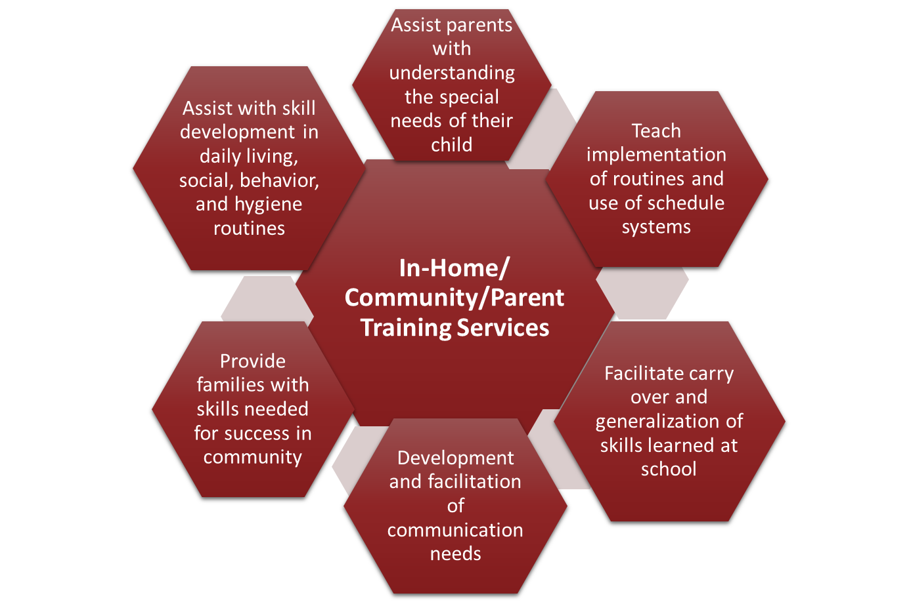
In-Home/Community Based/Parent Training

Slide 30
In-Home/Community Based/Parent Training
PARENT RESOURCES:
Autism Speaks: https://www.autismspeaks.org/caregiver-skills-training-program
Pacer Center: https://www.pacer.org/workshops/?gad_source=1&gclid=CjwKCAjw7-SvBhB6EiwAwYdCAcbnHBLnBkrGPM6dLFsUsKUMZi-FwGvvp7RV4SCZeAY7uXgAZBnh8BoCrvoQAvD_BwE
Texas Project FIRST: http://www.texasprojectfirst.org
Texas Parent to Parent: https://www.txp2p.org/
Guide By Your Side: https://txhv.org/gbys
Do2Learn.com: http://www.do2learn.com
Social Stories: http://www.thegraycenter.org
Parent Support https://www.tsd.state.tx.us/apps/pages/parents

Slide 31
Is a student with a disability who needs only a related service but not special education eligible for related services under IDEA?
  No. A student with a disability who only needs a related service and not special education is not eligible under the IDEA and hence is not eligible to receive related services.
Frequently Asked Questions

Slide 32
Do parents have to pay for the related services a child receives?
  No. School districts may not charge parents of eligible students with disabilities for the costs of related services that have been included in the child's IEP.
Frequently Asked Questions

Slide 33
Questions?

Slide 34

THANK YOU!

Slide 35

FORT BEND ISD
16431 Lexington Blvd.
Sugar Land, TX 77479
281-634-1000
www.fortbendisd.com

